Slide 1
Novice Helper: Eclipse Integrated Development Environment Plugin to Support Novice Programmers
By: Caroline Berger
Supervised By: Professor Martin Robillard
Notes:
My name is Caroline Berger. I’m a second year majoring in Computer Science. This semester, I was supervised by Martin Robillard.

Slide 2
Overview
Motivation
Relevant Research
Research Hypothesis
Novice Helper Goals
Solution
Programming Exercises
Error Dictionary
Software Implementation
Demo
Conclusion
Continuing Research

Slide 3
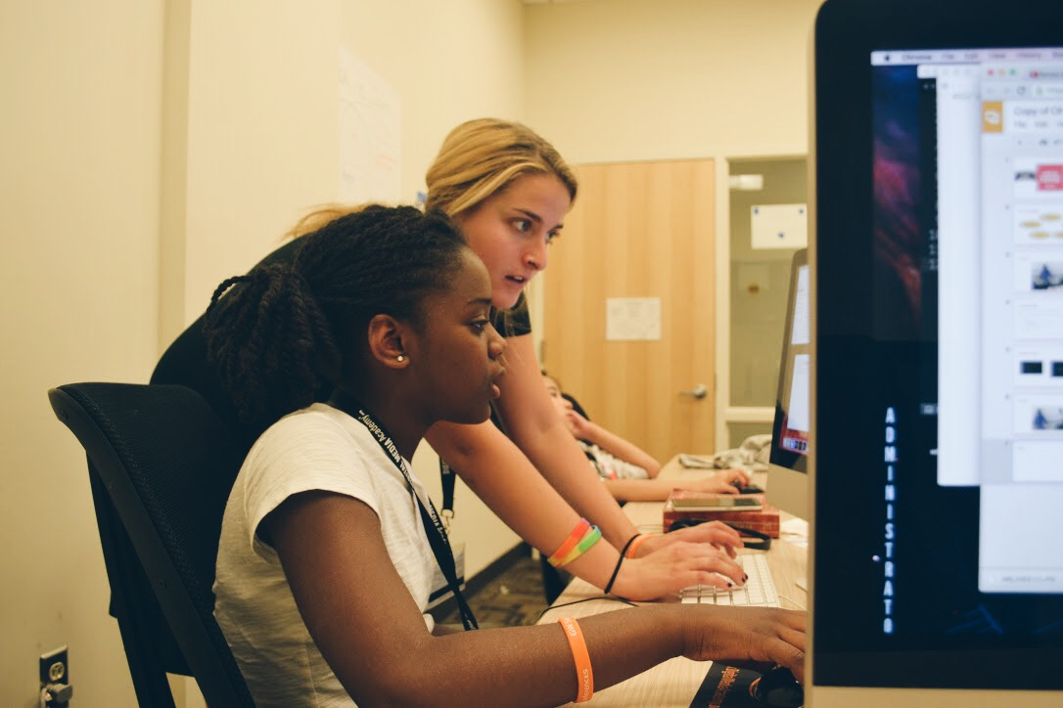
Motivation
Notes:
Last summer, I taught programming to children aged 8 – 12. I was told by the camp directors to use a drag and drop tool called scratch. After using Scratch to make a few projects, I noticed that Scratch eliminated the key process of debugging.

Slide 4
Relevant Research
Programming literacy, curriculum development
Textual programming languages vs visual programming languages
Tools: BlueJ, Alice, Expresso vs Scratch, Lightbot
Notes:
Programming literacy becoming a cornerstone in cirriculum
Unlearning that has to occur with transition, no debugging aspect
Own editors, support a pre existing editor - Eclipse

Slide 5
Novice Helper Goals
used in conjunction with a set of educational exercises
variables
types
loops
scope
control flow
provide helpful debugging advice
scaffold learning process
smooth transition into independent projects
Notes:
Predefined exercises -> independent projects

Slide 6
Research Hypothesis
Users aged 9 through 12 can learn elementary computer science concepts by programming in a professional development environment with support from the Novice Helper Plugin.

Slide 7
Solution
Programming exercises
Error Dictionary
Novice Helper Plugin
Notes:
Created a series of 5 exercises aimed to teach beginner students variables, types, loops, scope and control flow, coded solutions, tried to break solutions, created error dictionary that matches java compiler output with a translation that is appropriate to age, then used translation pairs in Novice Helper Plugin

Slide 8
Solution
Problem Occurs
Select Problem in Problems View
Novice Helper Message Appears
Notes:
Created a series of 5 exercises aimed to teach beginner students variables, types, loops, scope and control flow, coded solutions, tried to break solutions, created error dictionary that matches java compiler output with a translation that is appropriate to age, then used translation pairs in Novice Helper Plugin

Slide 9
Example Exercise: Introduction to Variables
Tell a story about your family, favorite sport, what you did last weekend or something else entirely. Use your creativity! Declare and use at least 3 different types of variables and print your story to the console. This should be done in the main method.

Slide 10
Problem Occurs
Select Problem in Problems View
JavaTutor
Message Appears

Slide 11
Java error message | Novice Helper message
Type mismatch: cannot convert from int to boolean | Java is a typed language. Variables of type boolean can be assigned to true or false.
Type mismatch: cannot convert from double to int | Java is a typed language. Variables of type int must be assigned to whole number values.
Type mismatch cannot convert from int to String | Java is a typed language. For a number to be considered a String, the number must have quotation marks around it “ ”.
Type mismatch cannot convert form boolean to int | Java is a typed language. Variables of type int must be assigned to whole number values.
string cannot be resolved to a type | String must be capitalized.

Slide 12
Error Dictionary Entry
int myAge = 12.5;
Java error:
Type mismatch: cannot convert from double to int
Error Translation:
Java is a typed language. Variables of type int must be assigned to whole number values or null.

Slide 13
Software Implementation
Notes:
Eclipse Software Development Kit

Slide 14
Eclipse Architecture
Novice Helper Plugin

Slide 15
Structure

Slide 16
Notes:
UML class diagram
The Adapter and Decorator was used to work with inner IMarker resources and ViewPart that are predefined by the Eclipse Architecture.

Slide 17
Demo

Slide 18
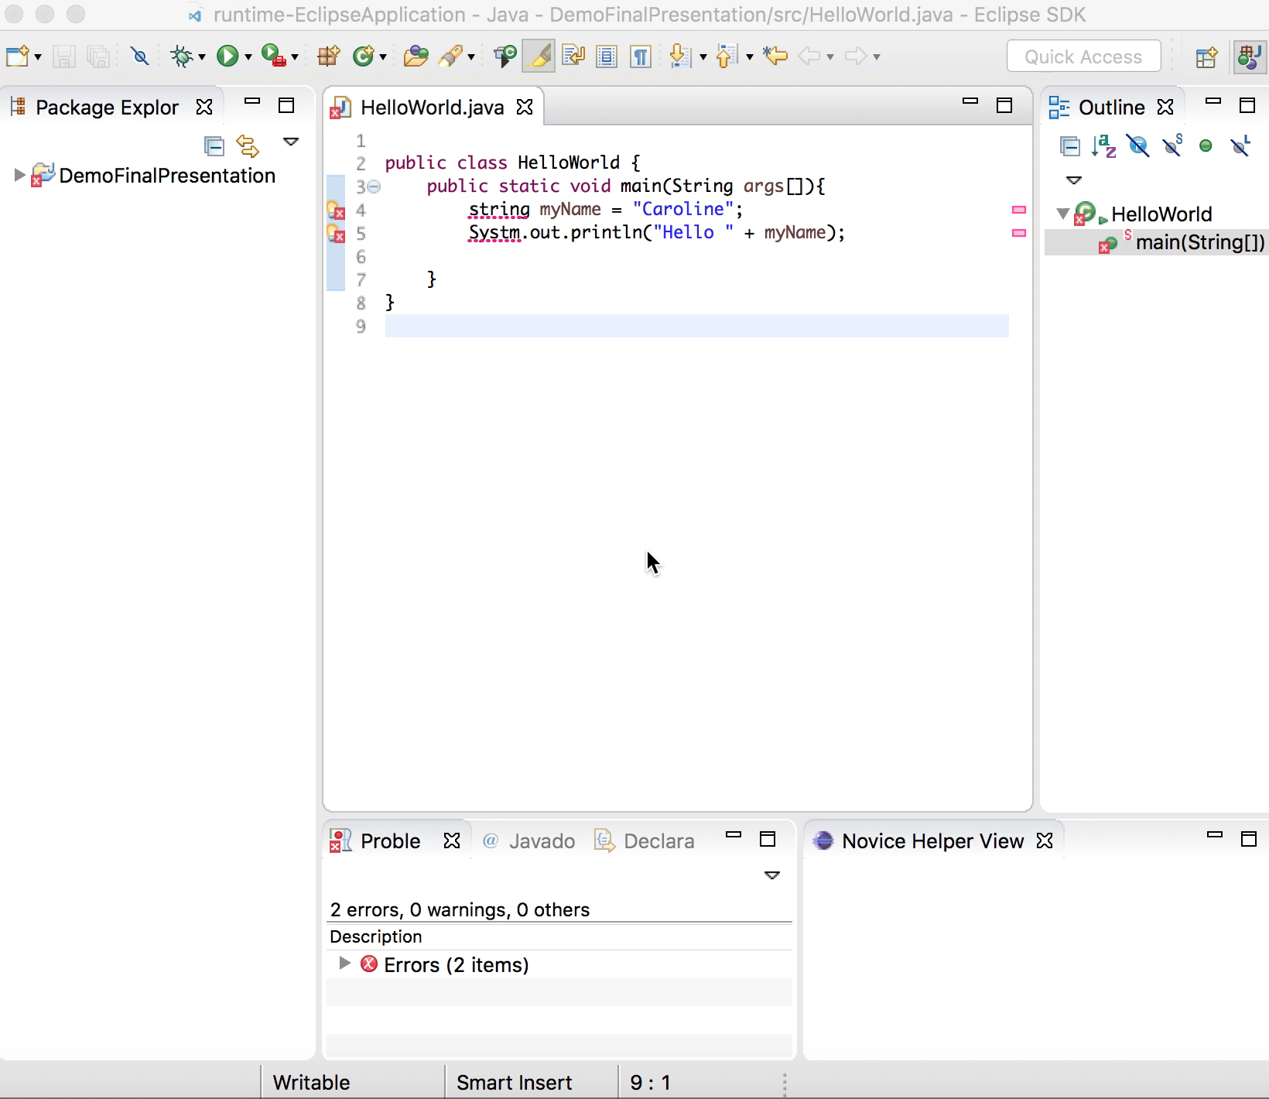

Slide 19
Conclusion
Novice Helper, an Eclipse Integrated Development Environment (IDE) Plugin aims to teach young students about computer science and programming by translating Java’s compiler error messages into age appropriate debugging advice embedded with computer science concepts.

Slide 20
Continuing Research
Improvements
Software: better error translation process
General: hone exercise problems and error translations
Summer 2017: Applying for approval for a user study to test Novice Helper on users aged 9 through 12
Notes:
Rocha Falcow

Slide 21
Acknowledgments
I would like to thank my supervisor, Professor Martin Robillard for his guidance and support throughout the project.
I would like to thank Dr. Taciana Pontual da Rocha Falcao from McGill’s Department of Education who provided insight and expertise in creating the exercises and error translations.
Notes:
Rocha Falcow

Slide 22
Citations
Scratch [Screen Shot]. (n.d.). Retrieved from http://news.mit.edu/sites/mit.edu.newsoffice/files/images/2013/20130514110054-1_0_0.jpg
Platform architecture. (n.d.). Retrieved from Eclipse Help website: https://help.eclipse.org/neon/ index.jsptopic=%2Forg.eclipse.platform.doc.isv%2Fguide%2Farch.htm
W. Robinson. From Scratch to Patch: Easing the Blocks-Text Transition. In Proceedings of the 11th Workshop in Primary and Secondary Computing Education, WiPSCE ’16 2016, pages 96-99, New York, NY, USA, 2016. ACM. ISBN 978-1-4503-4223-0. doi 10.1145/2978249.2978265
H. Tsukamoto, Y. Takemura and Y. Oomori. Textual vs. Visual Programming Languages in Programming Education for Primary Schoolchildren. In Frontiers in Education Conference, FIE 2016.
G. Marceau, K. Fisler and S. Krishnamurthi. Mind your language: On novices’ interactions with error messages. In Proceedings of the 10th SIGPLAN Symposium on New Ideas, New Paradigms, and Reflections on Programming and Software, Onward! 2011, pages 3-18, New York, NY, USA, 2011. ACM. ISBN 978-1-4503-0941-7. doi 10.1145/2048237.2048241
J. Jackson, M. Cobb and C. Carver. Identifying Top Java Errors for Novice Programmers. In Proceedings of the Frontiers in Education Conference.
Guzidial, M., Ericson, B. (2005). Introduction to Computing and Programming in Java: A Multimedia Approach. Upper Saddle River, NJ: Prentice Hall.
Lister, R., Leaney, J. (2003). 5th Australasian Computer Education Conference. First Year Programming: Let All the Flowers Bloom.
Pomerantz, D. (2015, October 5). Assignment 1 COMP 202.
Shiffman, D. (2015). Learning Processing. Burlington, MA: Morgan Kaufmann.

Slide 23
Thank you! Questions? Comments? caroline.berger2@mail.mcgill.ca

